Slide 1
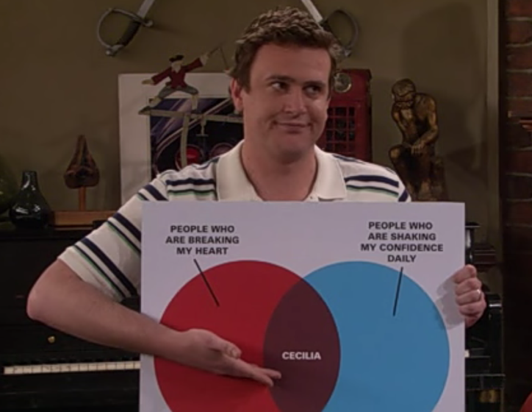
Your data tells a story

Slide 2
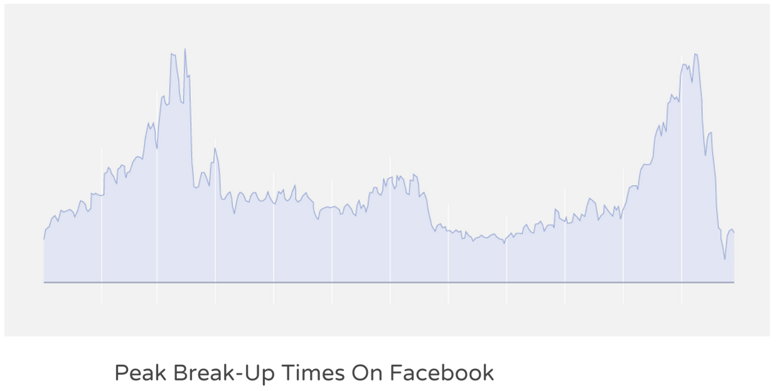
What is the story here?

Slide 3
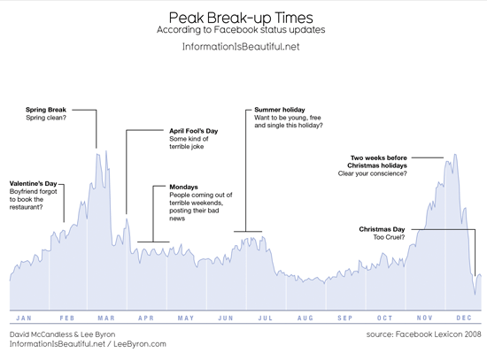

Slide 4
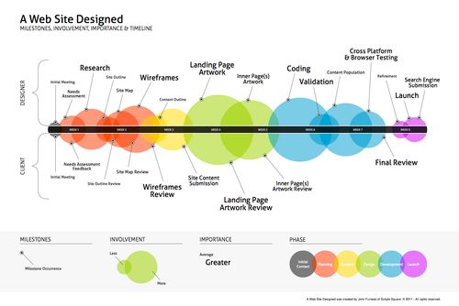

Slide 5
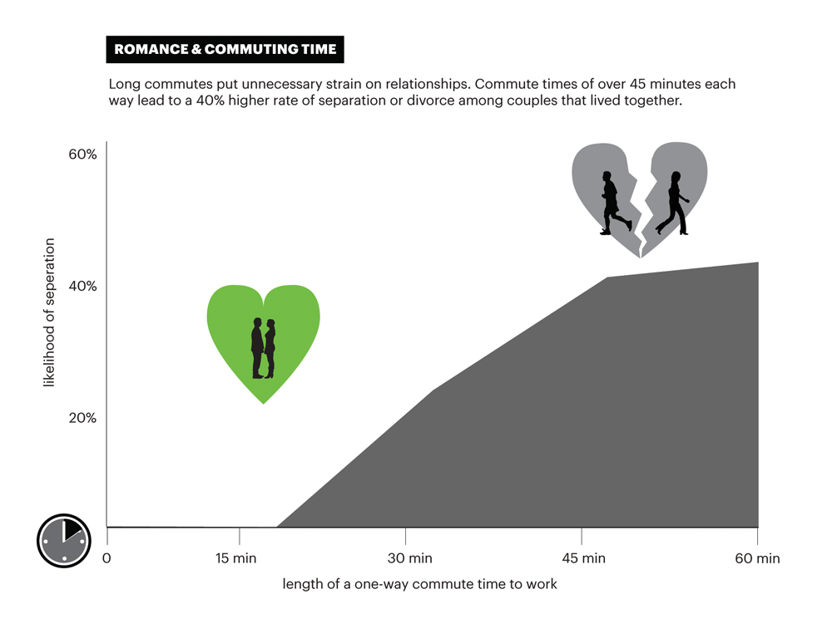

Slide 6
Anatomy of a Graph

Slide 7
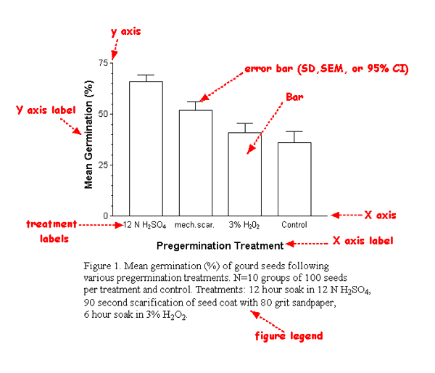

Slide 8
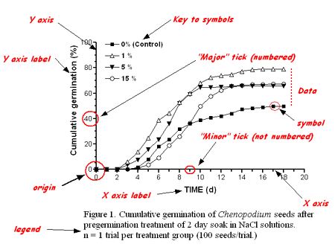

Slide 9
Graphical Hierarchy

Slide 10
Ground and figure
Assign bright colors (red, orange, yellow, green, blue) to important graphic elements
Features are known as figure, or the subject of the map.
Assign drab colors to the graphic elements that provide orientation or context, especially shades of gray
Features known as ground, or the context for the subject.

Slide 11
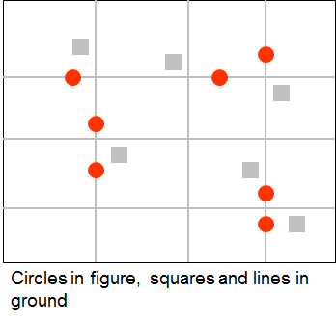
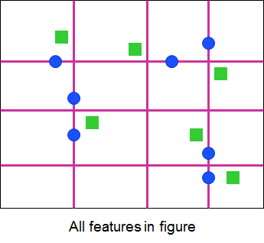
GOOD
BAD

Slide 12
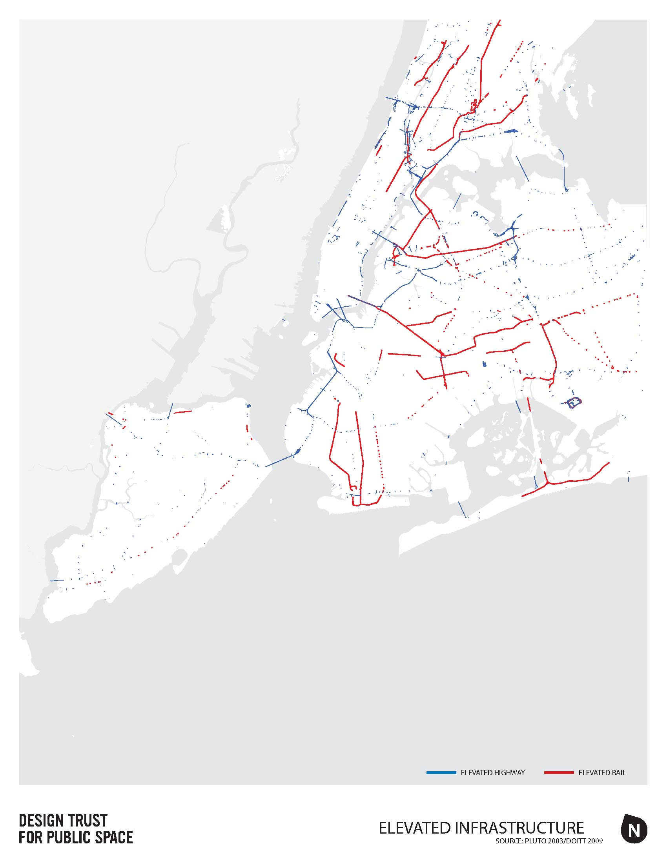

Slide 13
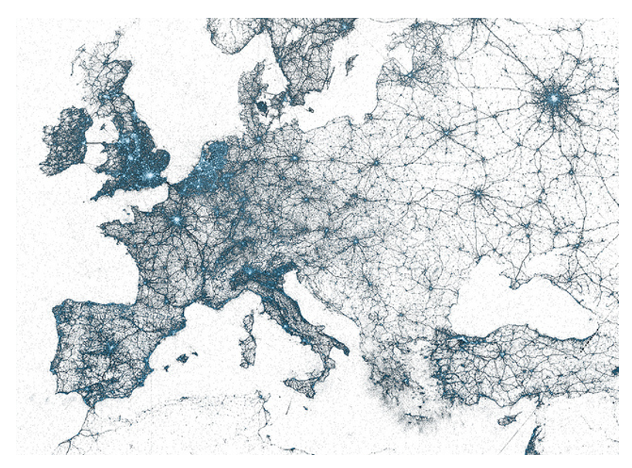
A single visualization can reveal unforeseen patterns present in truly massive data sets. For example, Twitter created visualizations of geotagged tweets to combine billions of data points into beautiful images of human activity.

Slide 14
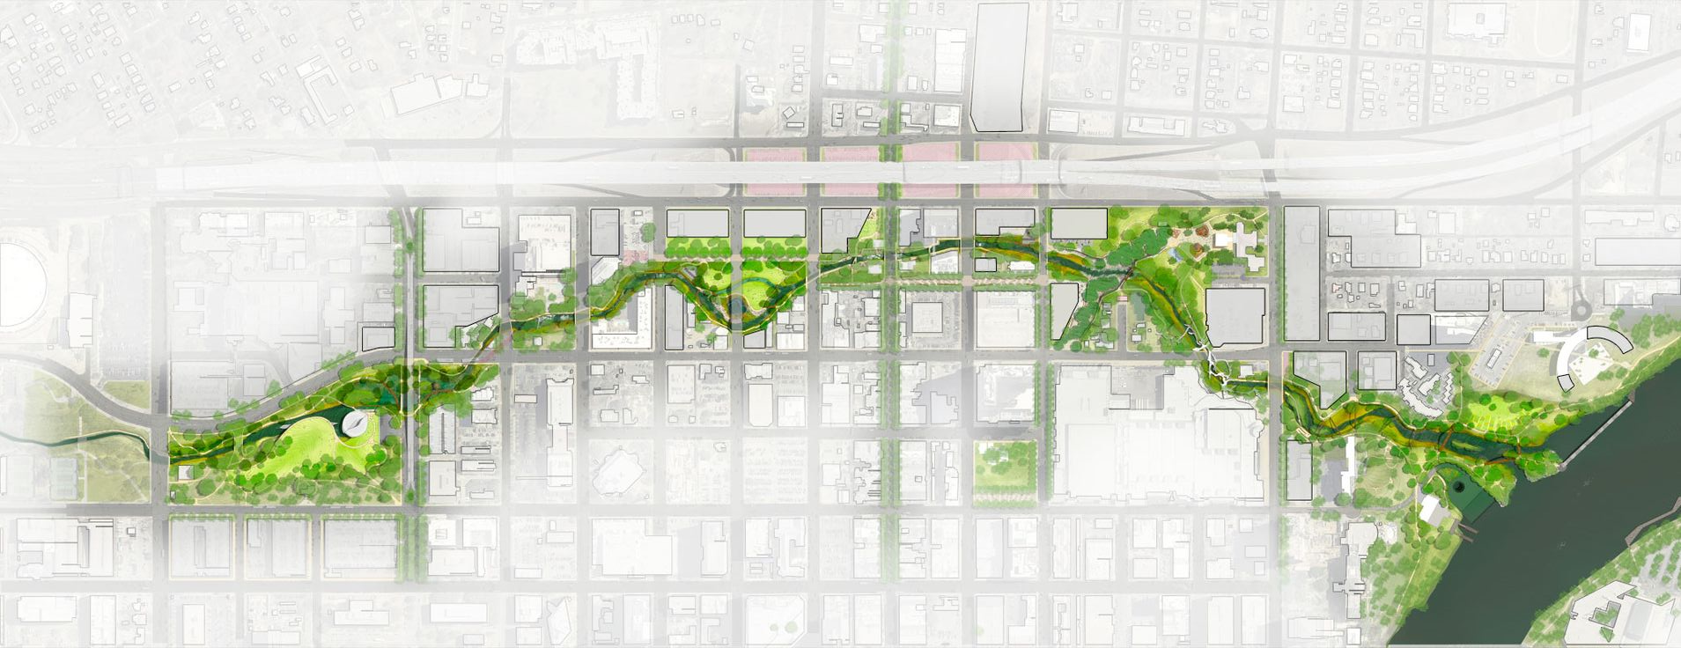
Connecting pocket parks makes cities coherent
Austin, TX
http://www.mvvainc.com/project.php?id=99&c=urban_design

Slide 15
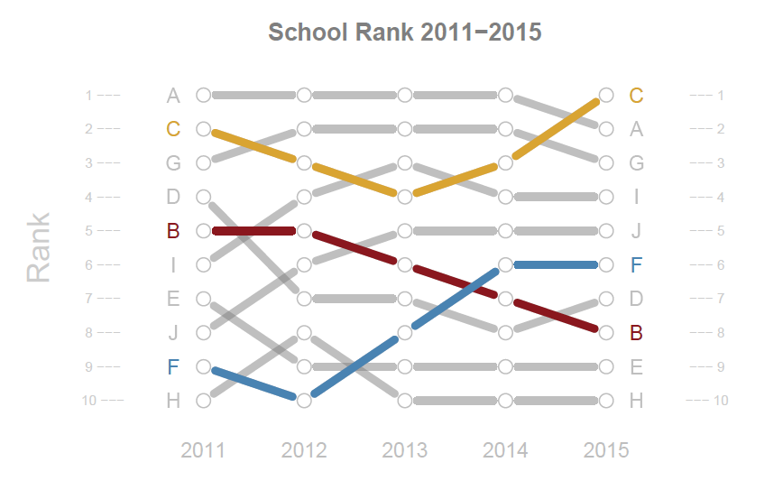

Slide 16
Label Data

Slide 17
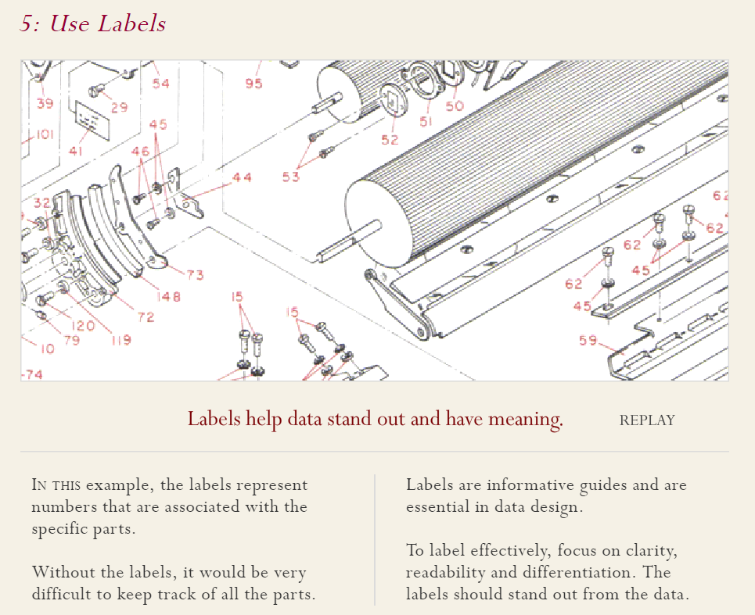

Slide 20
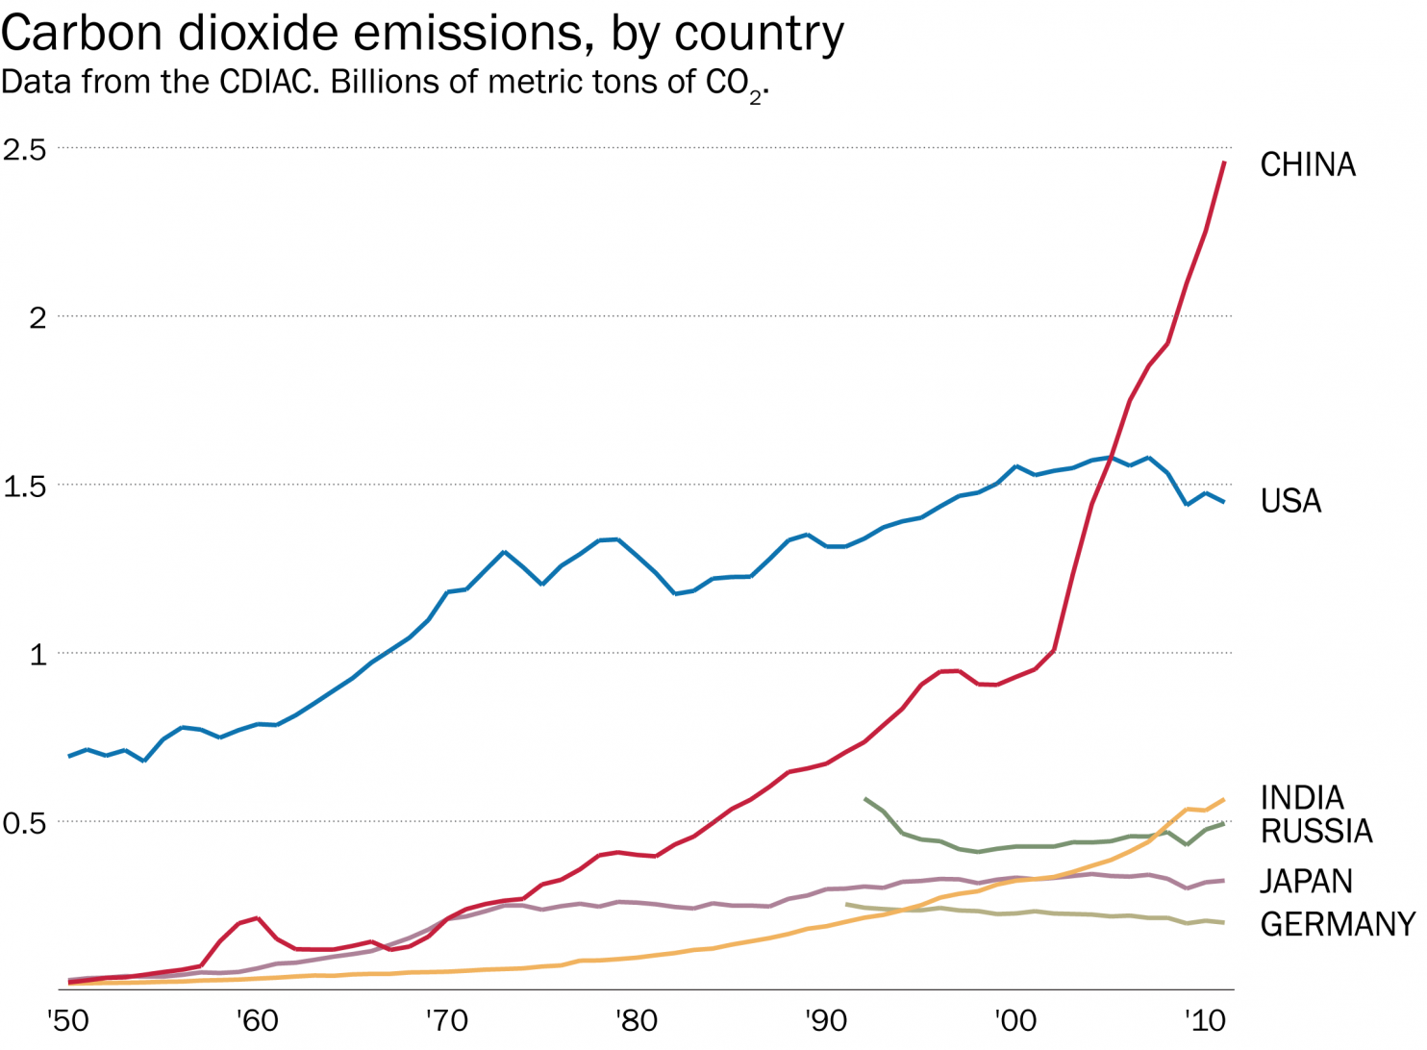

Slide 25
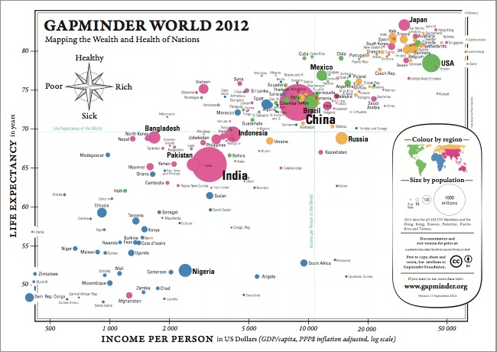

Slide 26
Be Honest

Slide 27
Which of these maps tells the story better?

Slide 28
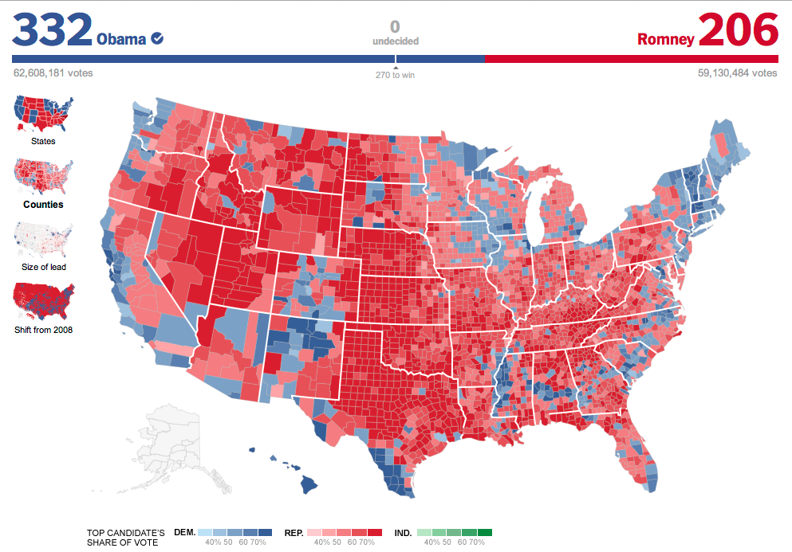

Slide 29
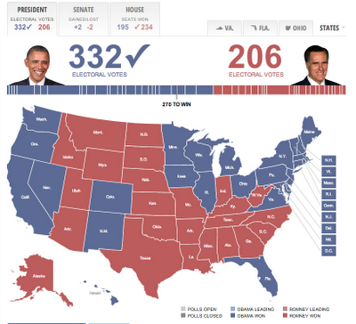

Slide 30
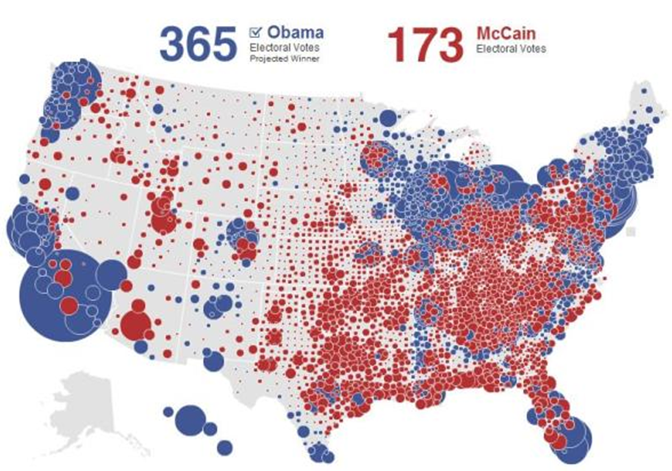

Slide 31
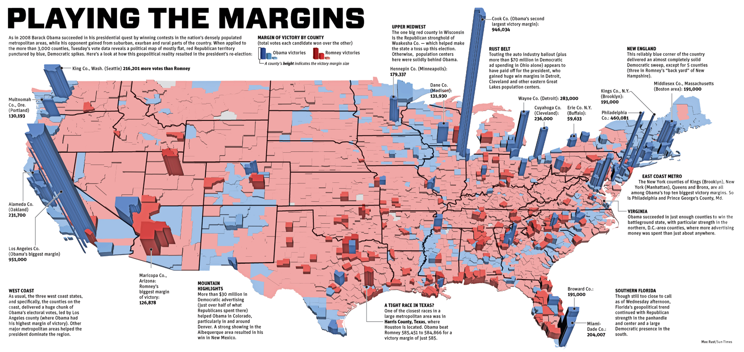

Slide 32
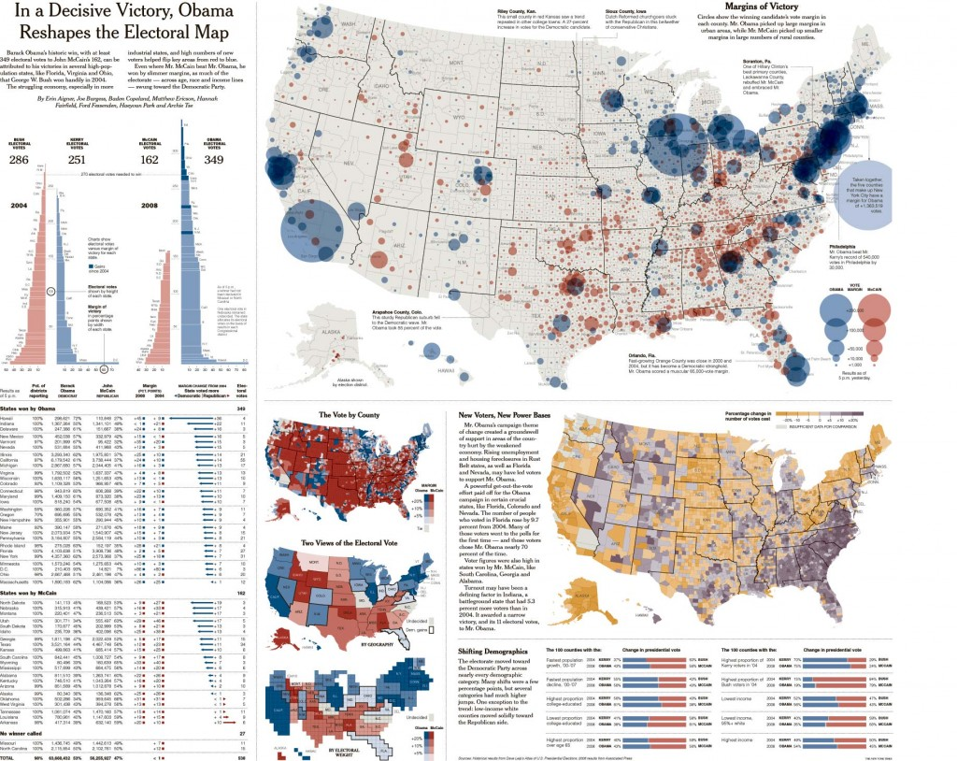

Slide 33
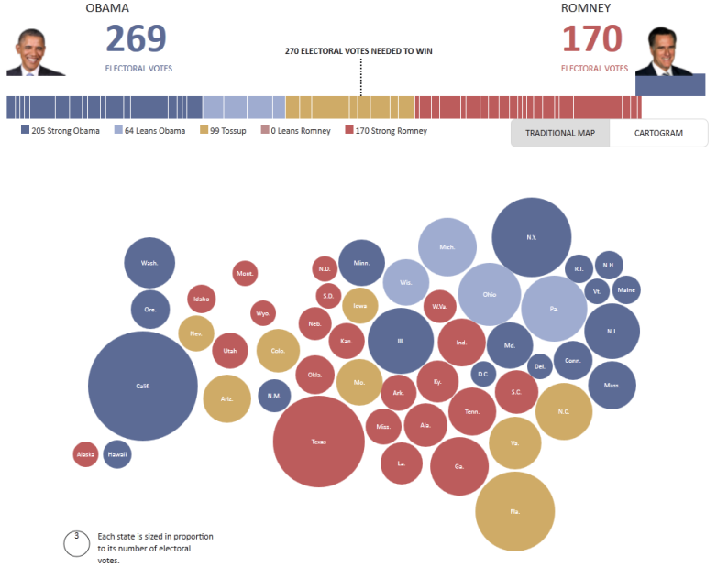

Slide 34
By emphasizing integrity of the wrong element (geography versus population density here), you may mislead your audience.

Slide 35
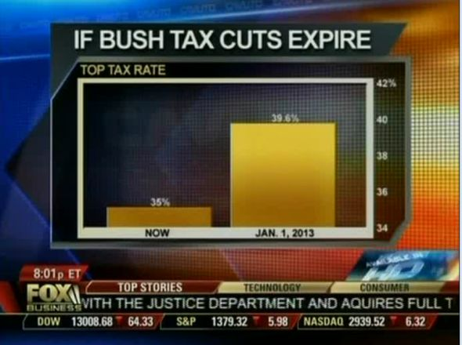
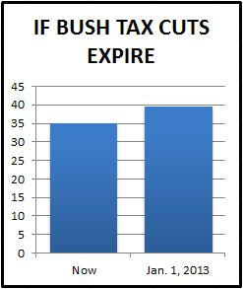
http://www.vox.com/2015/11/19/9758062/y-axis-zero-chart

Slide 36
Honest Visualization = Intention + Execution

Slide 37
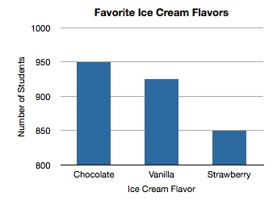
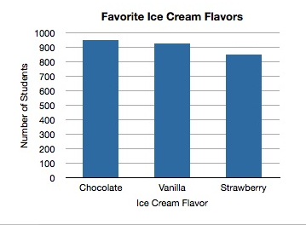

Slide 38
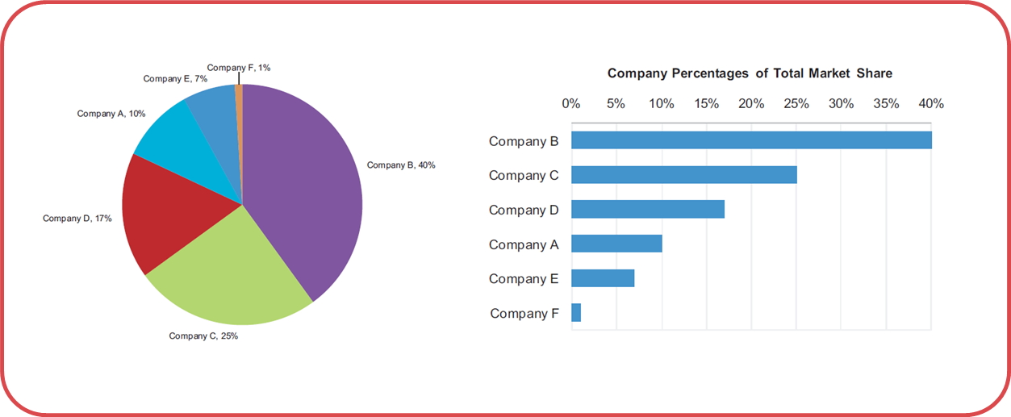
Never use pie charts

Slide 39
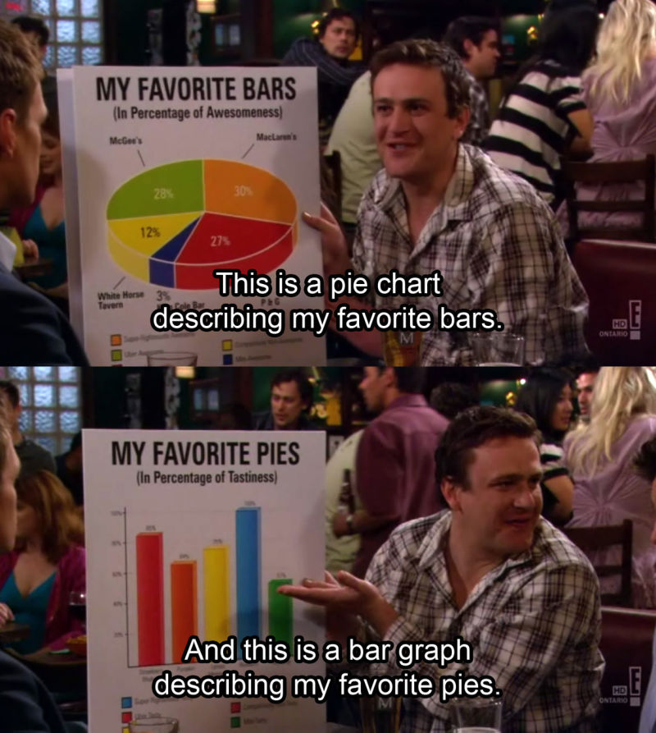
Unless it’s this pie chart
http://hackerspace.kinja.com/5-rules-for-making-graphs-1605706367

Slide 40
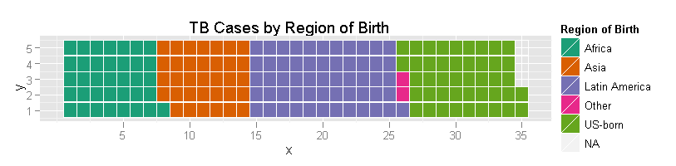

Slide 41
Drilling Down

Slide 42
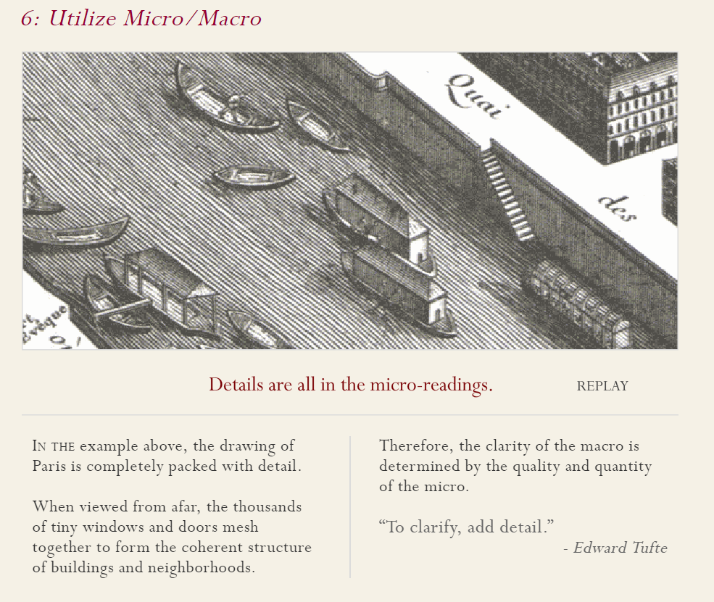

Slide 43
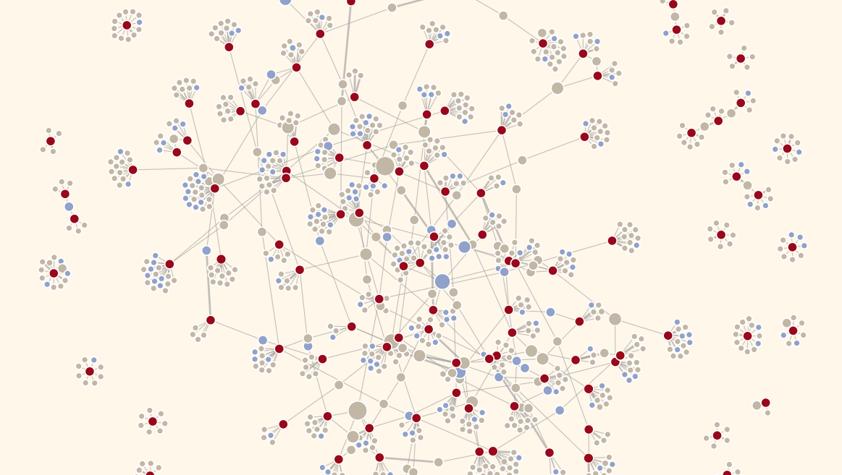
https://multimedia.tijd.be/bestuurders/

Slide 44
http://www.sealthreinhold.com/school/tuftes-rules/rule_one.php
Rules 5-6

Slide 45
Small Multiples

Slide 46
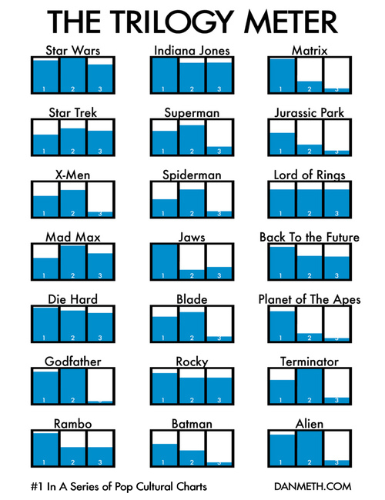
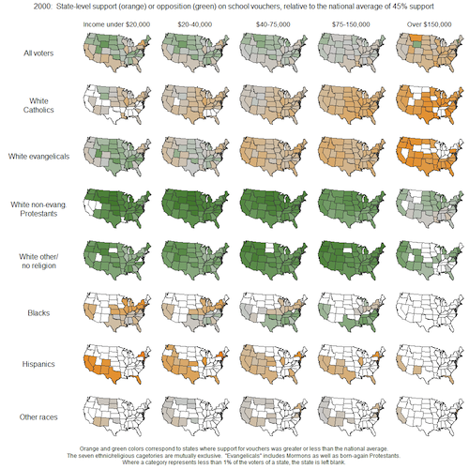

Slide 47
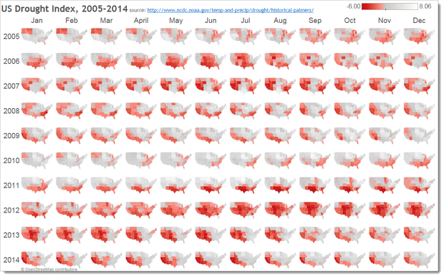

Slide 48
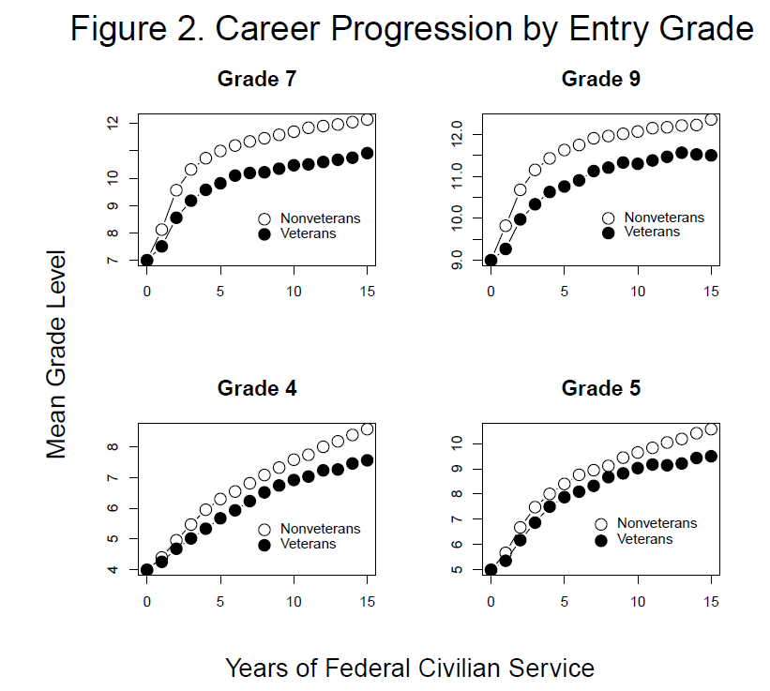

Slide 50
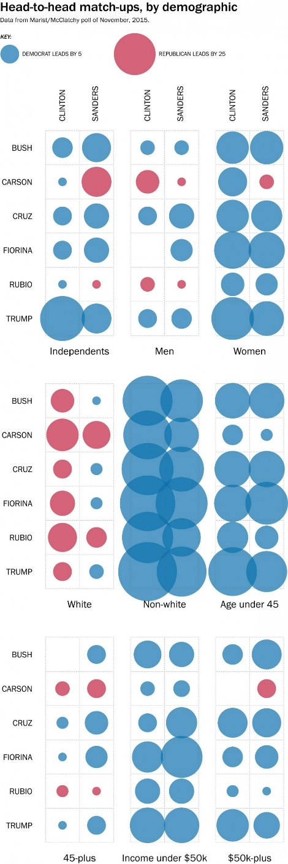

Slide 51


Slide 52
Remove Chart Junk

Slide 53
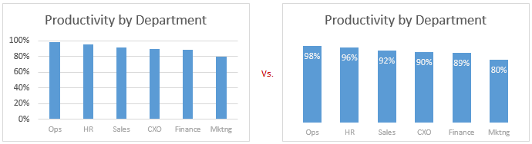
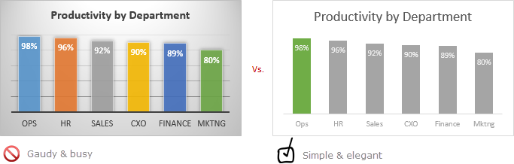

Slide 54
Colors Have Meaning

Slide 55
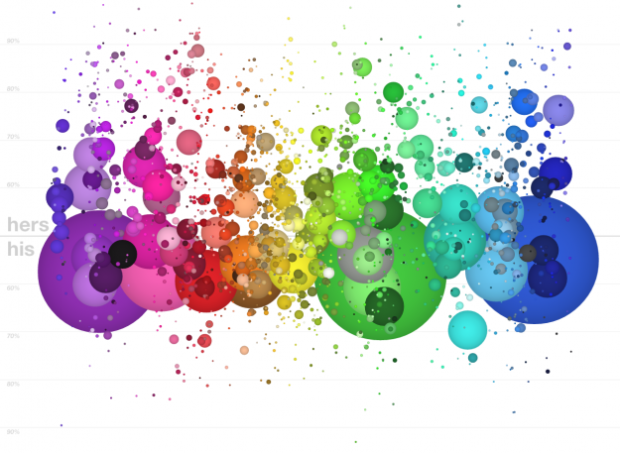
Red is the color of energy, passion, action, ambition and determination. It is also the color of anger and passion.
Orange is the color of social communication and optimism. From a negative color meaning it is also a sign of pessimism and superficiality.
Yellow is the color of the mind and the intellect. It is optimistic and cheerful. However it can also suggest impatience, criticism and cowardice.
Green is the color of balance and growth. It can mean both self-reliance as a positive and possessiveness as a negative, among many other meanings.
Blue is the color of trust and peace. It can suggest loyalty and integrity as well as conservatism and frigidity.

Slide 56
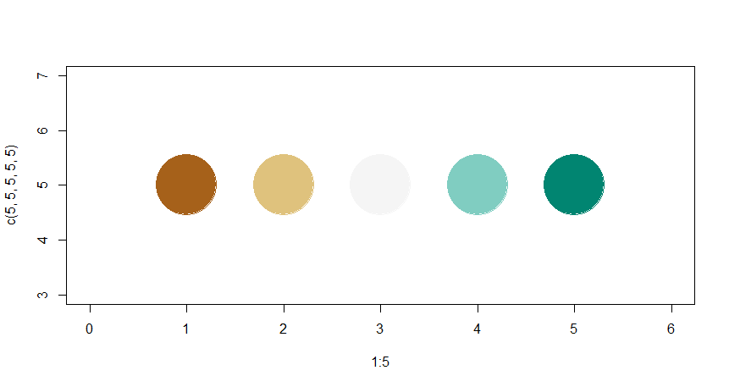
http://colorbrewer2.org/
color.vals <- c("#a6611a", "#dfc27d", "#f5f5f5", "#80cdc1", "#018571" )
plot( 1:5, c(5,5,5,5,5), col=color.vals, pch=19, cex=10, xlim=c(0,6) )

Slide 57
library( RColorBrewer )
display.brewer.pal( 7, "BrBG" )
display.brewer.pal( 5, "BrBG" )
display.brewer.pal( 7, "BuGn" )
brewer.pal( 5, "BrBG" ) # identical to previous slide
color.vals <- brewer.pal( 5, "BrBG" )

Slide 58
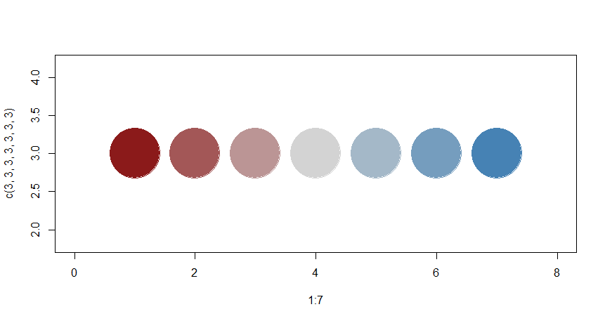
color.function <- colorRampPalette( c("firebrick4","light gray","steel blue" ) )
color.function(5) # number of classes you desire
col.vals <- color.function(7)
plot( 1:7, c(3,3,3,3,3,3,3), pch=19, cex=10, col=col.vals, xlim=c(0,8) )

Slide 59
norm.vec <- rnorm(10000) + 10
# Five groups, 20% of the data in each
quantile( norm.vec, probs=c(0, 0.20, 0.40, 0.60, 0.80, 1 ), na.rm=T )
# Seven groups
quantile( norm.vec, probs=seq( from=0, to=1, by=1/7 ), na.rm=T )

Slide 60
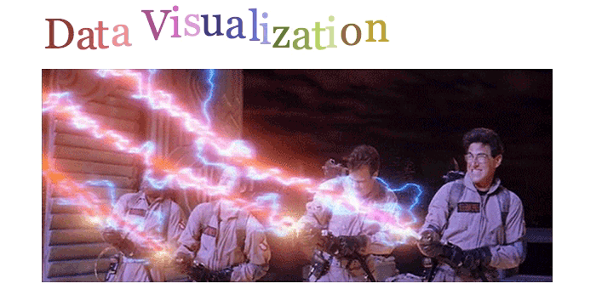
Movement Provides Information

Slide 61
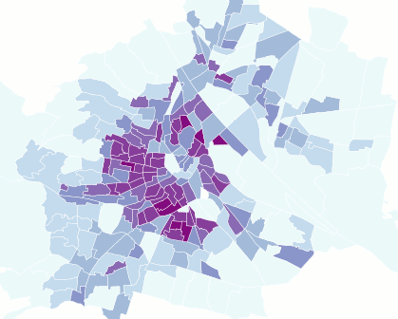
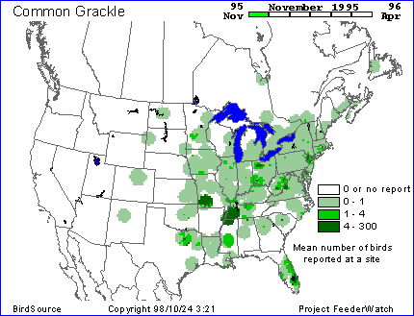
Two population density measures compared.
Migration patterns of birds.

Slide 62
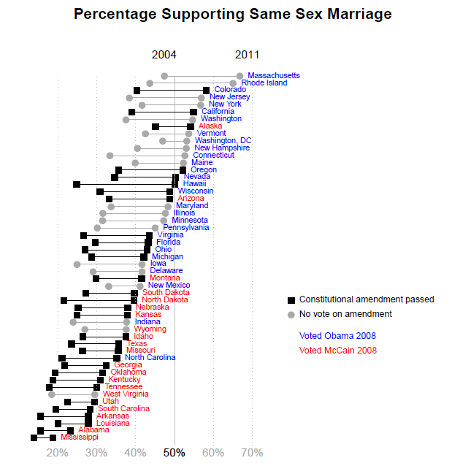

Slide 63
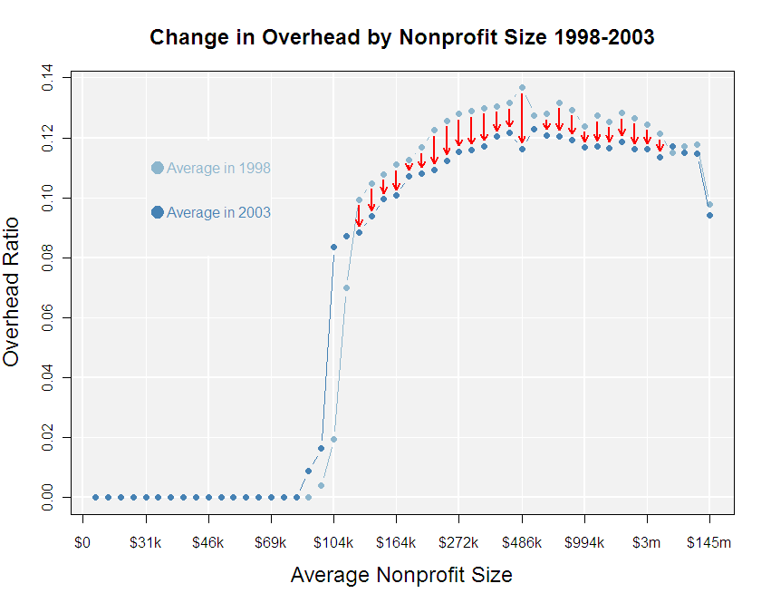

Slide 64
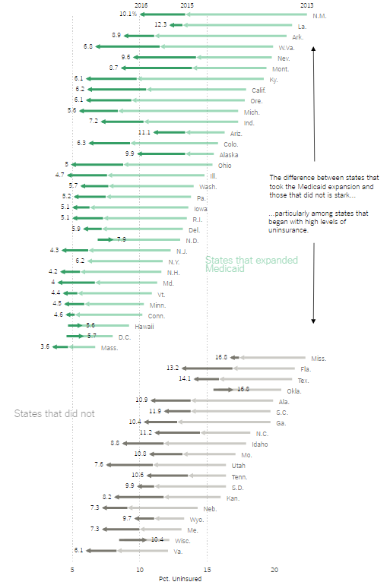
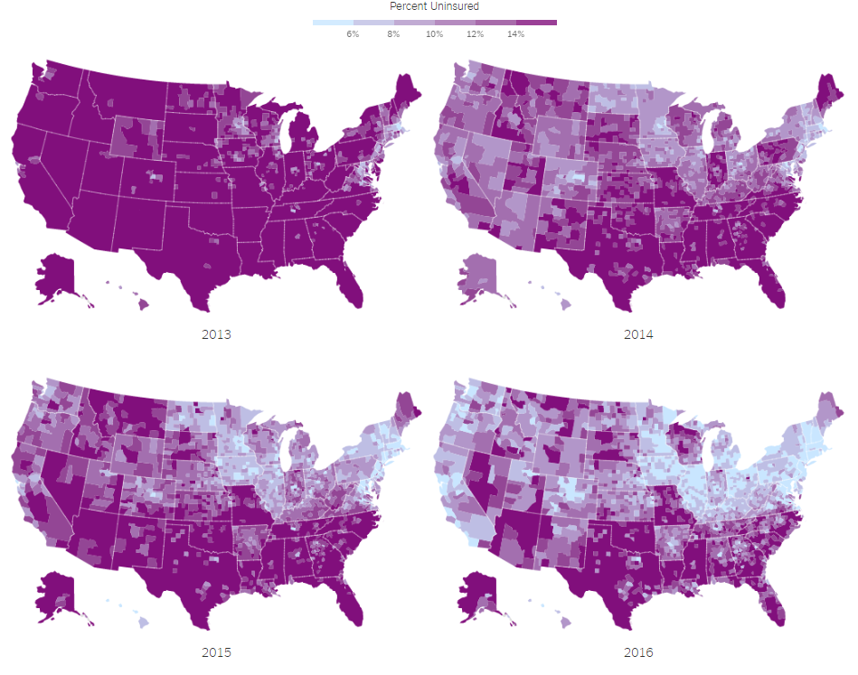
http://nyti.ms/2dUJdhz

Slide 65
https://www.nytimes.com/interactive/2018/03/19/upshot/race-class-white-and-black-men.html

Slide 66
Visualize Tables

Slide 67
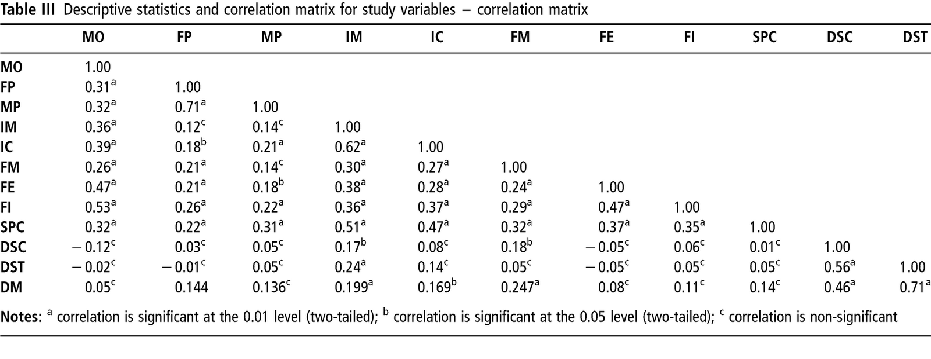

Slide 68
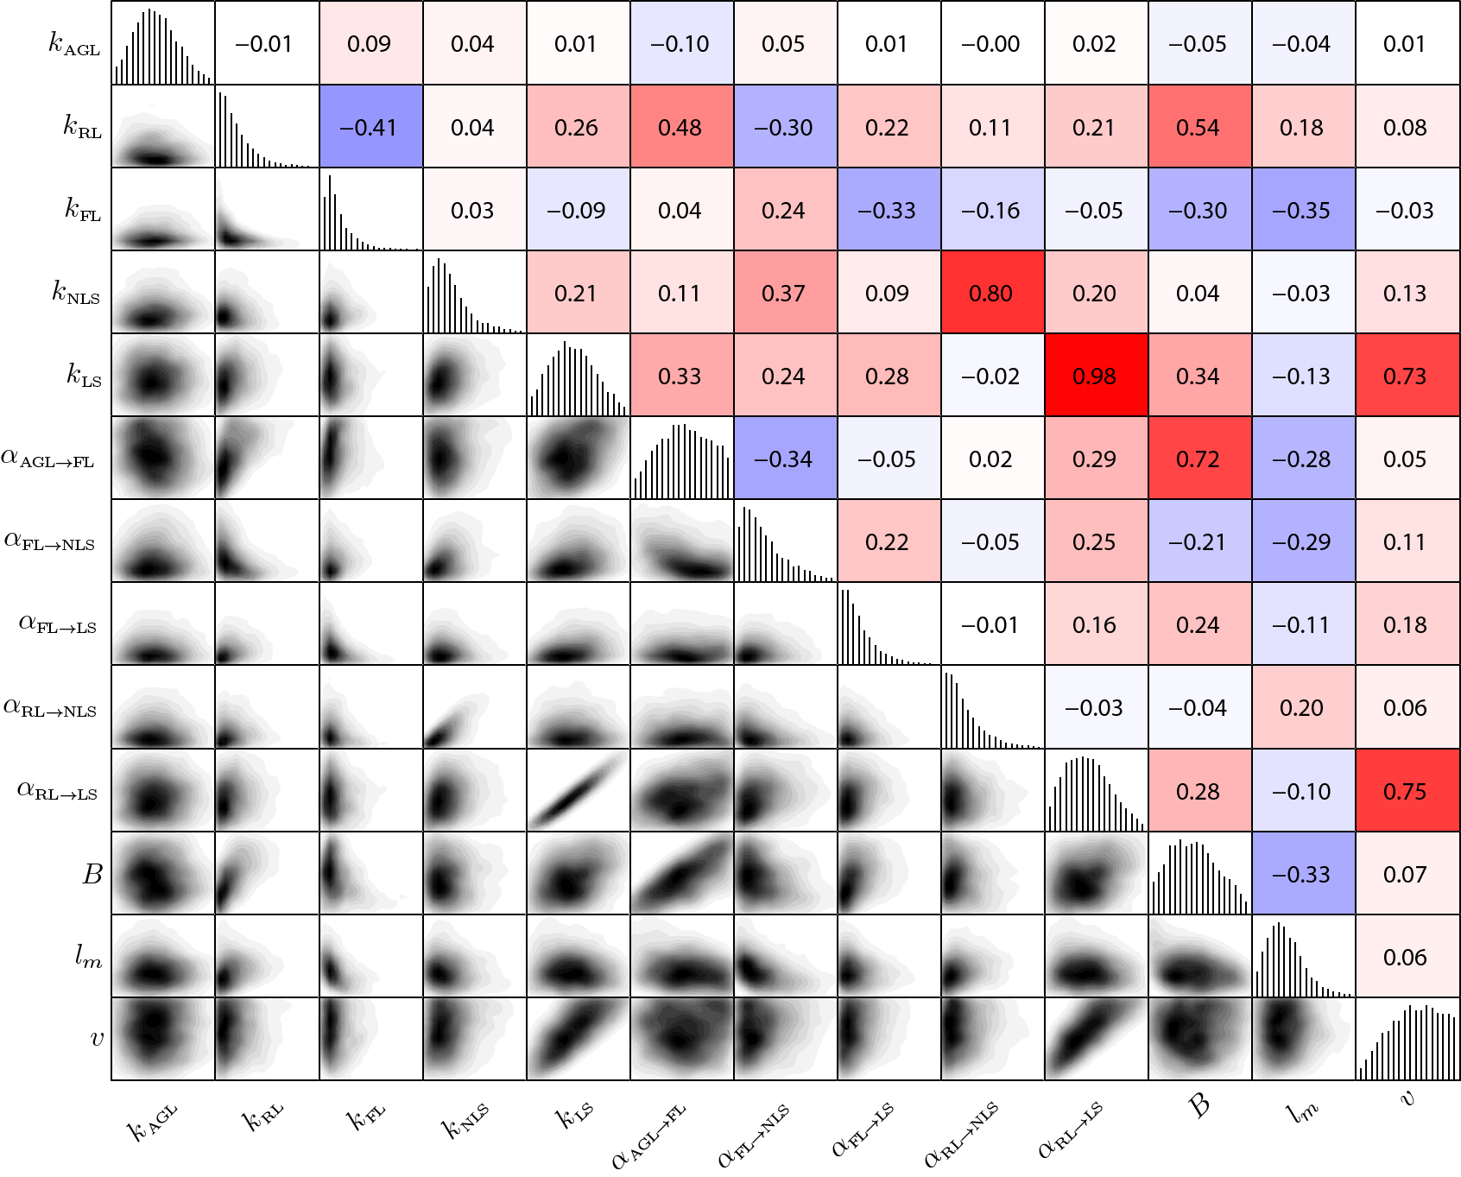

Slide 69
Table of Effect Sizes
 | ALL | ARTS | HEALTH | HUMAN SERVICES | PUBLIC | EDUCATION | OTHER
Surplus Ratio | 0.381 | 0.520 | 0.239 | 0.359 | 0.372 | 0.399 | 0.750
Professional Fundraising | 0.340 | 0.426 | 0.215 | 0.338 | 0.353 | 0.452 | 0.015
Government Revenue | 0.392 | 0.365 | 0.270 | 0.397 | 0.411 | 0.429 | 0.014
Accrual Accounting | 0.190 | 0.276 | 0.066 | 0.189 | 0.204 | 0.312 | 0.000
Equity Ratio | 0.114 | 0.193 | -0.035 | 0.096 | 0.206 | 0.253 | -0.008
Unrestricted Net Assets | 0.098 | 0.143 | -0.016 | 0.149 | 0.204 | 0.182 | -0.010
Fixed Cost Ratios | 0.042 | 0.125 | -0.081 | 0.048 | 0.049 | 0.139 | -0.010
Revenue Concentration | -0.022 | 0.072 | -0.142 | -0.030 | -0.002 | 0.100 | -0.015

Slide 70
Figure X: Effects Across Models
Effect Size Across Subsector Models
Surplus Ratio
Professional Fundraising
Government Revenue
Accrual Accounting
Equity Ratio
Unrestricted Net Assets
Fixed Cost Ratios
Revenue Concentration
-0.1
0
0.1
0.2
0.3
0.4
0.5
0.6
0.7
0.8
Increase in Probability of Professionalization

Slide 71

http://www.amazon.com/Understanding-New-Statistics-Meta-Analysis-Multivariate/dp/041587968X/ref=sr_1_1?ie=UTF8&qid=1444273166&sr=8-1&keywords=the+new+statistics

Slide 72


Slide 73


Slide 74
In Conclusion

Slide 75
Twenty rules for good graphics
Use vec­tor graph­ics such as eps or pdf. These scale prop­erly and do not look fuzzy when enlarged. Do not use jpeg, bmp or png files as these will look fuzzy when enlarged, or if saved at very high res­o­lu­tions will be enor­mous files. Jpegs in par­tic­u­lar are designed for pho­tographs not sta­tis­ti­cal graphics.
Use read­able fonts. For graph­ics I pre­fer sans-​​serif fonts such as Hel­vetica or Arial. Make sure the font size is read­able after the fig­ure is scaled to what­ever size it will be printed.
Avoid clut­tered leg­ends. Where pos­si­ble, add labels directly to the ele­ments of the plot rather than use a leg­end at all. If this won’t work, then keep the leg­end from obscur­ing the plot­ted data, and make it small and neat.
If you must use a leg­end, move it inside the plot, in a blank area.
No dark shaded back­grounds. Excel always adds a nasty dark gray back­ground by default, and I’m always ask­ing authors to remove it. Graph­ics print much bet­ter with a white back­ground. The ggplot for R also uses a gray back­ground (although it is lighter than the Excel default). I don’t mind the ggplot ver­sion so much as it is used effec­tively with white grid lines. Nev­er­the­less, even the light gray back­ground doesn’t lend itself to printing/​photocopying. White is better.
Avoid dark, dom­i­nat­ing grid lines (such as those pro­duced in Excel by default). Grid lines can be use­ful, but they should be in the back­ground (light gray on white or white on light gray).
Keep the axis lim­its sen­si­ble. You don’t have to include a zero (even if Excel wants you to). The defaults in R work well. The basic idea is to avoid lots of white space around the plot­ted data.
Make sure the axes are scaled prop­erly. Another Excel prob­lem is that the hor­i­zon­tal axis is some­times treated cat­e­gor­i­cally instead of numer­i­cally. If you are plot­ting a con­tin­u­ous numer­i­cal vari­able, then the hor­i­zon­tal axis should be prop­erly scaled for the numer­i­cal variable.
Do not for­get to spec­ify units.
Tick inter­vals should be at nice round numbers.
Axes should be prop­erly labelled.
Use linewidths big enough to read. 1pt lines tend to dis­ap­pear if plots are shrunk.
Avoid over­lap­ping text on plot­ting char­ac­ters or lines.
Fol­low Tufte’s prin­ci­ples by remov­ing chart junk and keep­ing a high data-​​ink ratio.
Plots should be self-​​explanatory, so include detailed captions.
Use a sen­si­ble aspect ratio. I think width:height of about 1.6 works well for most plots.
Pre­pare graph­ics in the final aspect ratio to be used in the pub­li­ca­tion. Dis­torted fonts look awful.
Use points not lines if ele­ment order is not relevant.
When prepar­ing plots that are meant to be com­pared, use the same scale for all of them. Even bet­ter, com­bine plots into a sin­gle graph if they are related.
Avoid pie-​​charts. Espe­cially 3d pie-​​charts. Espe­cially 3d pie-​​charts with explod­ing wedges. I promise all my stu­dents an instant fail if I ever see any­thing so appalling.
http://robjhyndman.com/hyndsight/graphics/

